Slide 1
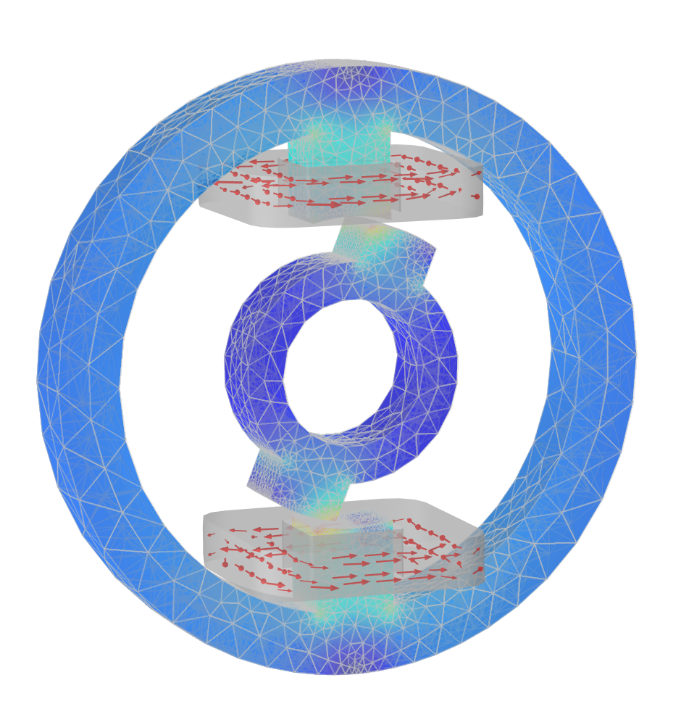
Switched Reluctance Motor
Notes:
https://www.comsol.com/model/28011

Slide 2
Introduction
The motor works on the principle of Reluctance torque.
  Exciting the stator winding results in a torque pulling the rotor towards the position of minimum reluctance.
Simulating the transient behavior of motor when excited with an applied step voltage the rotor being at standstill.
The solid ferromagnetic core is partly saturated, affecting current, magnetic flux and torque.
Measured data available at: http://www.compumag.org/jsite/team.html (Problem 24)

Slide 3
Required results
Current in stator winding: I(t)
Total magnetic flux in rotor tooth: φ(t)
Rotor torque: T(t)
Point measurement of B in air gap: B_{y}(t)

Slide 4
Problem 1
The asympotic (DC) value of measured current is not consistent with applied voltage and DC resistance of winding.
  From input data: 23.1V/3.09Ω = 7.4757A
  Measurement: 7.41A (0.8% low)
  Using corrected resistance of 3.1174Ω in simulation

Slide 5
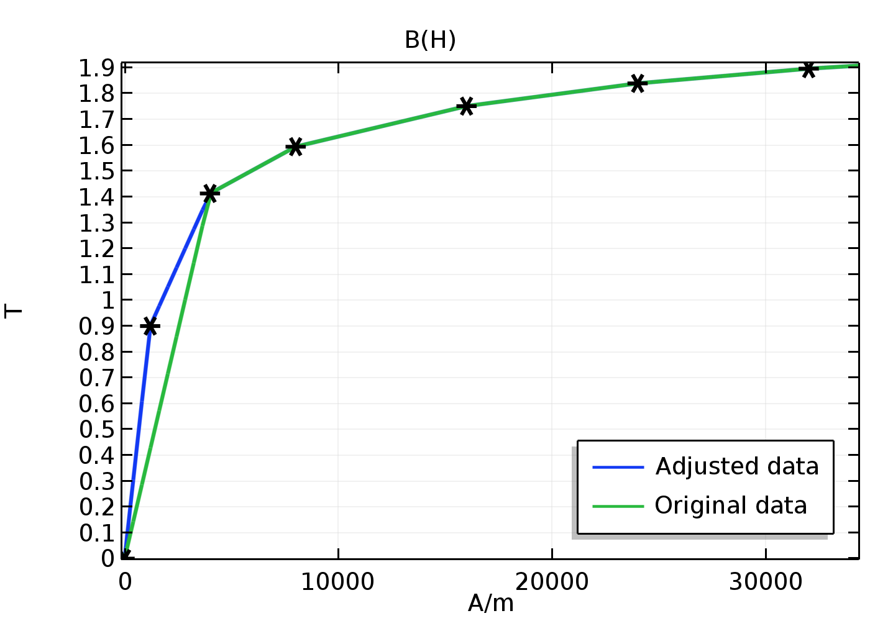
Problem 2
The low flux region of the supplied B-H curve is probably too sparsely sampled
Adding one more point.
Using cubic interpolation (not shown).
The results depend a fair deal on the positioning of the extra data point.

Slide 6
Problem 3
The point mesurement of B_{y}(t) is very sensitive to the position. Shifting the position radially outwards by 0.6% (0.3mm) causes a drop of 5% in B_{y}(t).
Experimental and simulation errors can be large!

Slide 7
Results

Slide 8
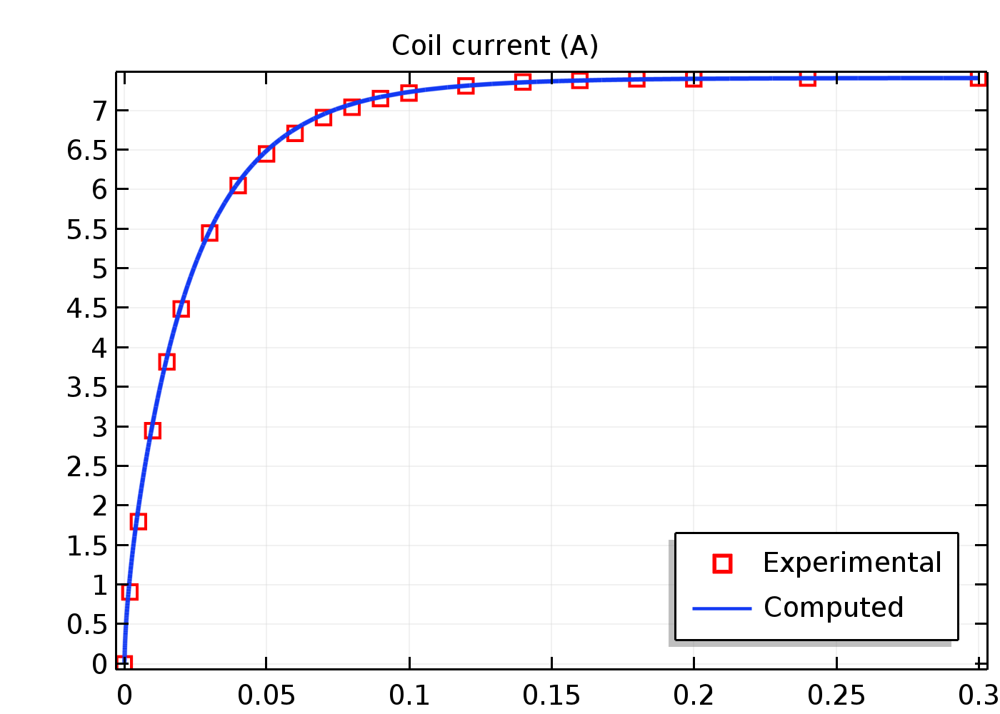
Stator coil current

Slide 9
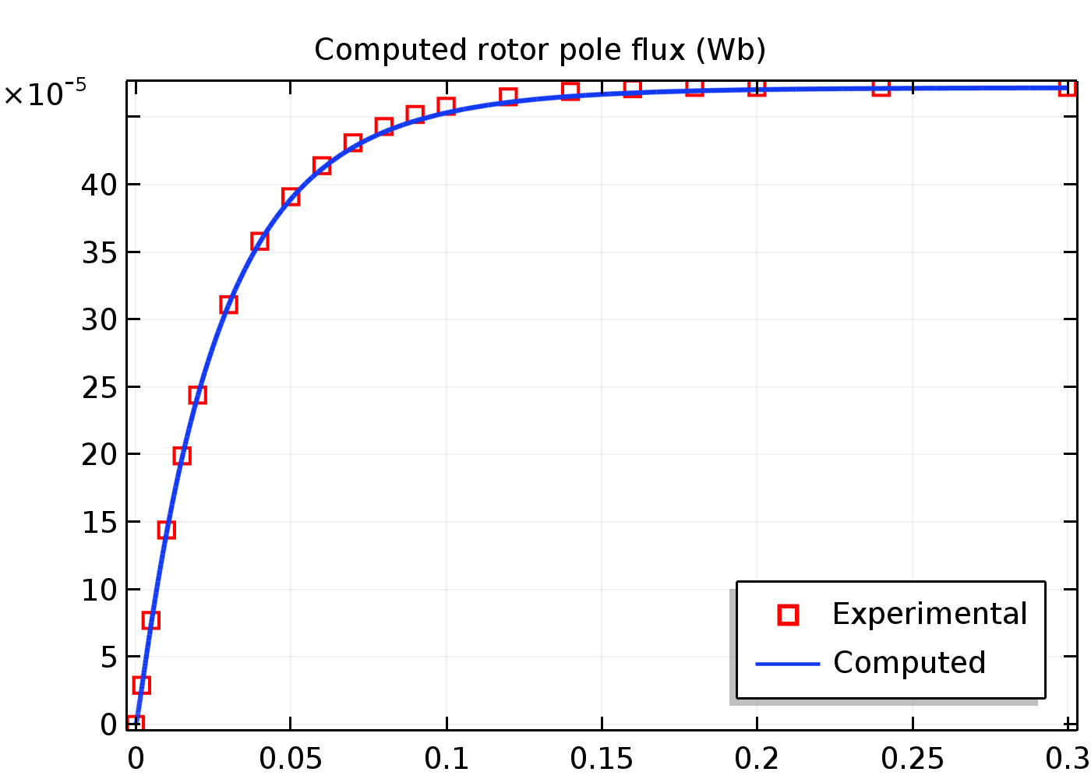
Magnetic Flux in rotor tooth

Slide 10
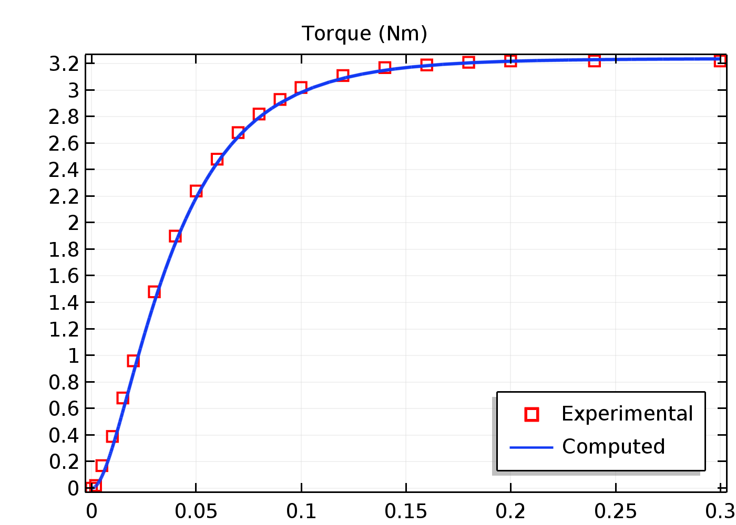
Rotor Torque

Slide 11
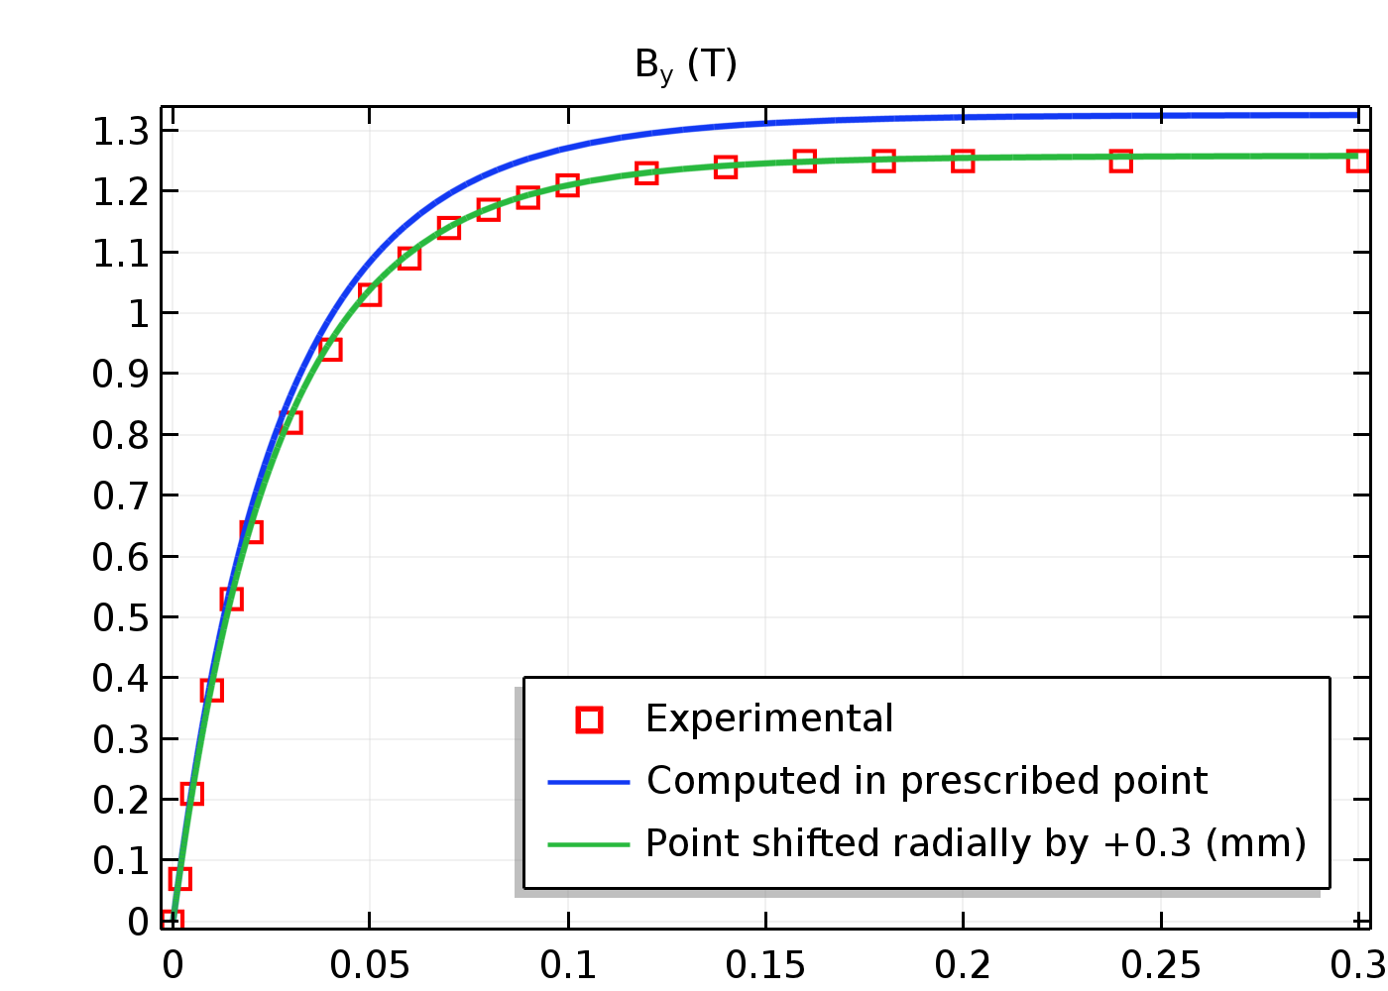
Magnetic Flux Density

Slide 12
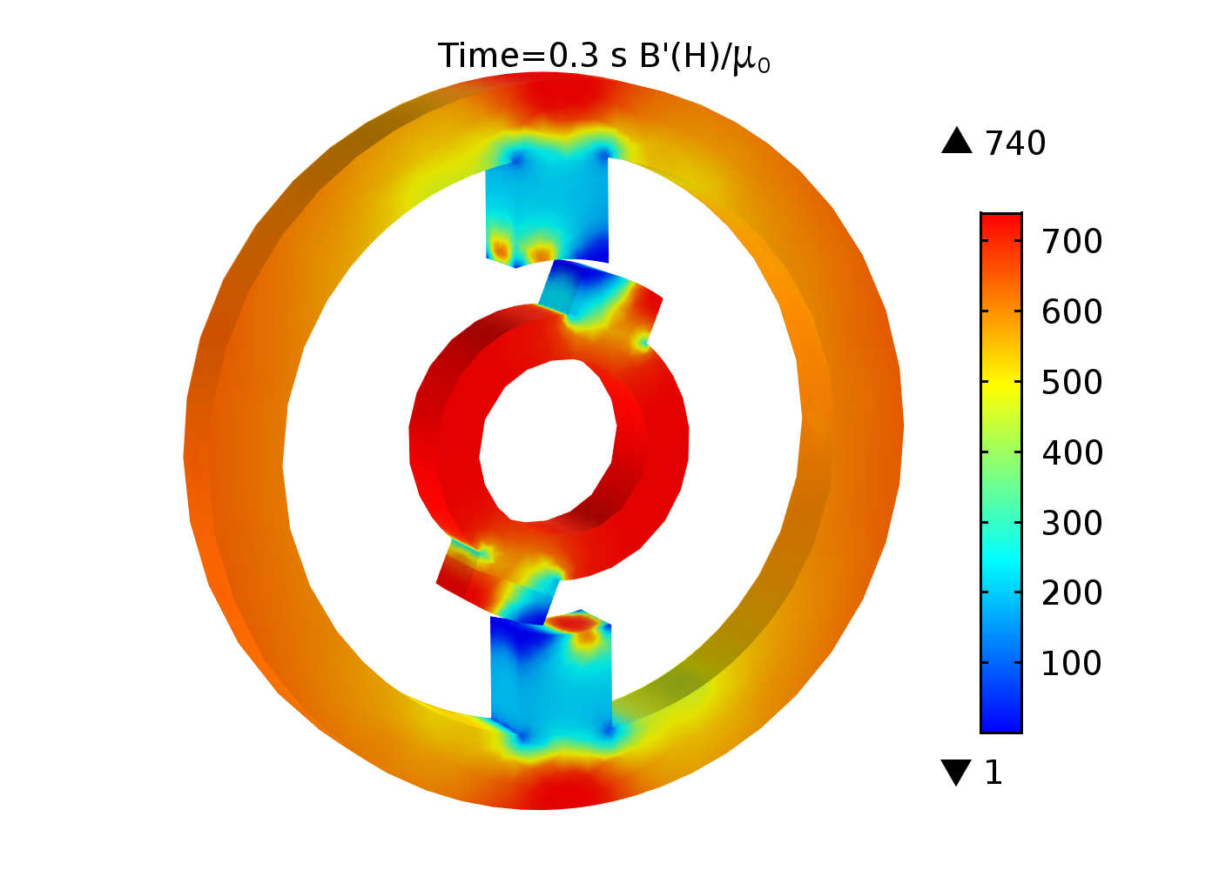
Saturation

Slide 13
Summary
Key modeling steps:
  Use the Magnetic Fields physics for the magnetic field and current distribution in Stator
  and rotor.
  Utilize axial mirror symmetry to reduce model size.
  Include the nonlinear B-H Curve in the magnetic part.
  Use Arkkio’s eggshell method to compute the torque acting on the rotor.
  Use a high mesh density near pole-tips to compute the magnetic saturation near pole
  tips accurately.
Important results
  Current and flux
  Torque on rotor
  Magnetic Field distribution
The results obtained with COMSOL are fairly consistent with experimental results but raise some questions regarding the consistency, validity and accuracy of the experimental data.

Slide 14
Notes
Model uses Linear Discretization for numerical stability.
  Recommended for models with magnetic saturation.
The coils were put in series using a circuit connection.

