Slide 1
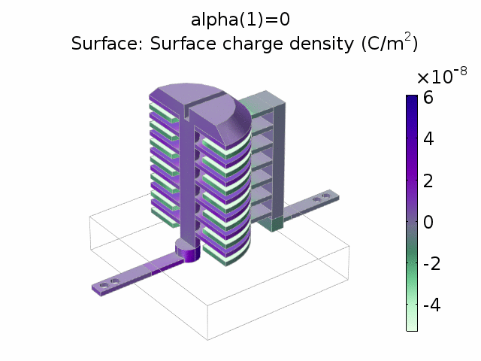
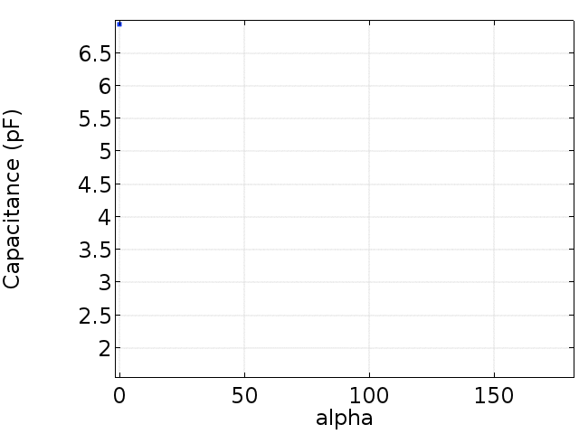
Trimmer Capacitor
A trimmer capacitor works by adjusting the electrode overlap.
The angular response is close to linear.

