Slide 1
Trimmer capacitor
COMSOL

Slide 2
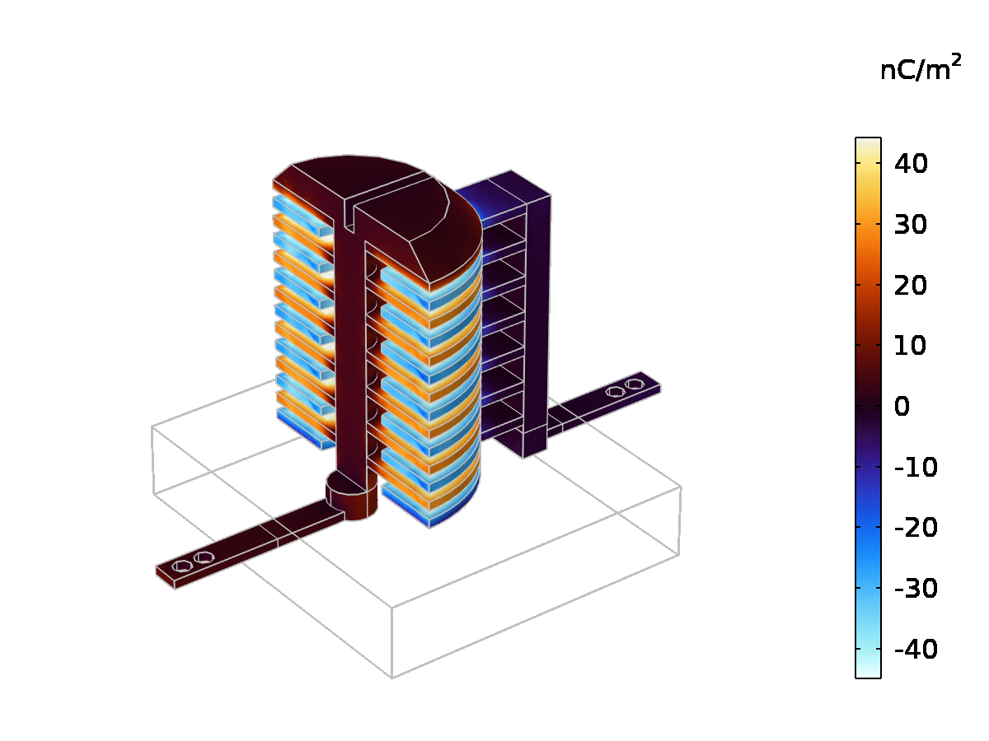
Surface Charge Density
A trimmer capacitor works by adjusting the electrode overlap.
An animation of the surface charge density on the capacitor as the tuning electrode rotates through angle alpha.

Slide 3
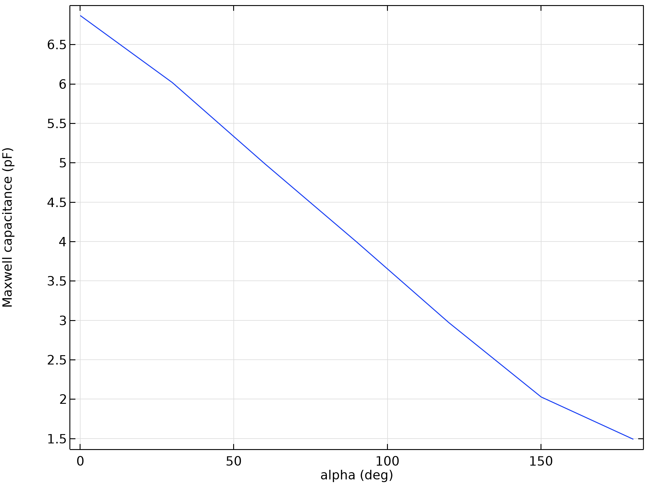
Maxwell Capacitance
The angular response is close to linear.
The calculated capacitance as a function of the tuning electrode angle alpha.

