Slide 1
Heat and moisture transport in a wall with air flow

Slide 2
Model description
A light-weight wall is simulated in the presence of an air flow between the interior and exterior depending on time.
During the first 20 days, the airflow goes from the interior to the exterior and in the reverse direction during the last 80 days.
Simulation lasts over 100 days with constant interior and exterior temperature.
1D model is defined in HAMSTAD-WP2 Modeling, Benchmark 3:
  Project for the validation of numerical simulations for coupled heat and moisture transport in building materials
  Reference: Hagentoft, C.E.: HAMSTAD WP 2 Modeling – Final report: Methodology of HAM-modeling R-02:8. Gothenburg, Department of Building Physics, Chalmers University of Technology (2002).
Model is built with Heat and Moisture Transport in Building Materials predefined interface.

Slide 3

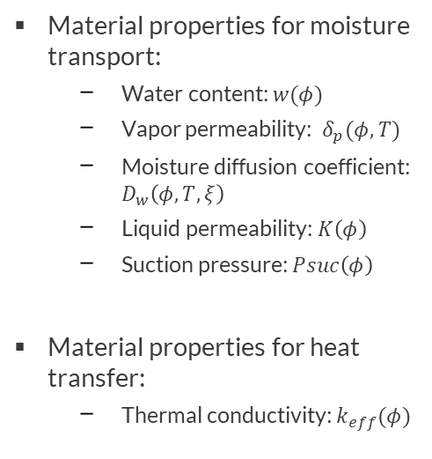
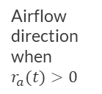


Geometry & Material properties
Exterior, $φ_{e}=0.8, T_{e}=2°C$
Airflow direction when $r_{a}(t)>0$
Single layer, 200 mm
$$φ_{0}=0.95, T_{0}=20°C$$
Material properties for moisture transport:
  Water content: $w(φ)$
  Vapor permeability: $δ_{p}(φ,T)$
  Moisture diffusion coefficient: $D_{w}\left(φ,T,ξ\right)$
  Liquid permeability: $K\left(φ\right)$
  Suction pressure: $Psuc\left(φ\right)$
Material properties for heat transfer:
  Thermal conductivity: $k_{eff}(φ)$
Interior, $φ_{i}=0.7, T_{i}=20°C$
1D model

Slide 4



Model definition
Heat transfer in Building Materials interface (Hagentoft eq. 65) :
$${\left(ρc_{p}\right)}_{eff}\frac{∂T}{∂t}+∇∙q=Q$$
Contribution of airflow
$$q=−(k_{eff}∇T+L_{v}δ_{p}∇\left(φp_{sat}\left(T\right)\right)−r_{a}\left(t\right)ρ_{air}{c_{p}}_{air}T−L_{v}r_{a}\left(t\right)v_{s})$$
Moisture transport in Building Materials interface (Hagentoft eq. 62):
Contribution of airflow
$$ξ\frac{∂φ}{∂t}+∇∙g=G−{∇∙(v}_{s}r_{a}(t))$$
Liquid transport by capillary suction forces
$$g=−(ξD_{w}∇φ+δ_{p}∇\left(φp_{sat}\left(T\right)\right)$$
Vapor diffusion
$$ξ=\frac{∂w}{∂φ}$$

Slide 5
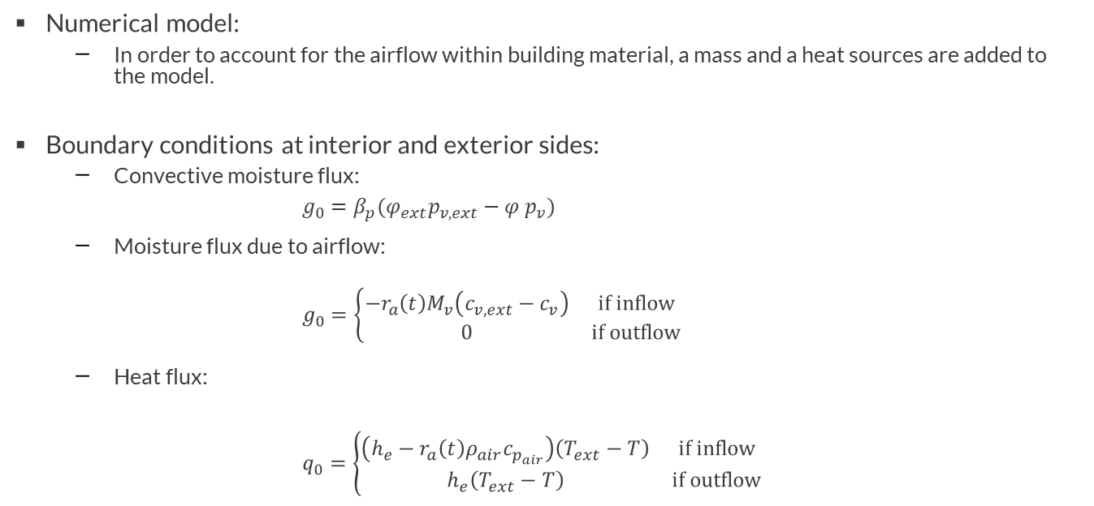
Model definition
Numerical model:
  In order to account for the airflow within building material, a mass and a heat sources are added to the model.
Boundary conditions at interior and exterior sides:
  Convective moisture flux:
  $g_{0}=β_{p}(φ_{ext}p_{v,ext}−{φ p}_{v})$
  Moisture flux due to airflow:
  $$g_{0}=\left\{\begin{matrix}−r_{a}\left(t\right)M_{v}\left(c_{v, ext}−c_{v}\right) & if inflow \\ 0 & if outflow\end{matrix}\right.$$
  Heat flux:
  $$q_{0}=\left\{\begin{matrix}\left(h_{e}−r_{a}\left(t\right)ρ_{air}c_{p_{air}}\right)\left(T_{ext}−T\right) & if inflow \\ h_{e}\left(T_{ext}−T\right) & if outflow\end{matrix}\right.$$

Slide 6
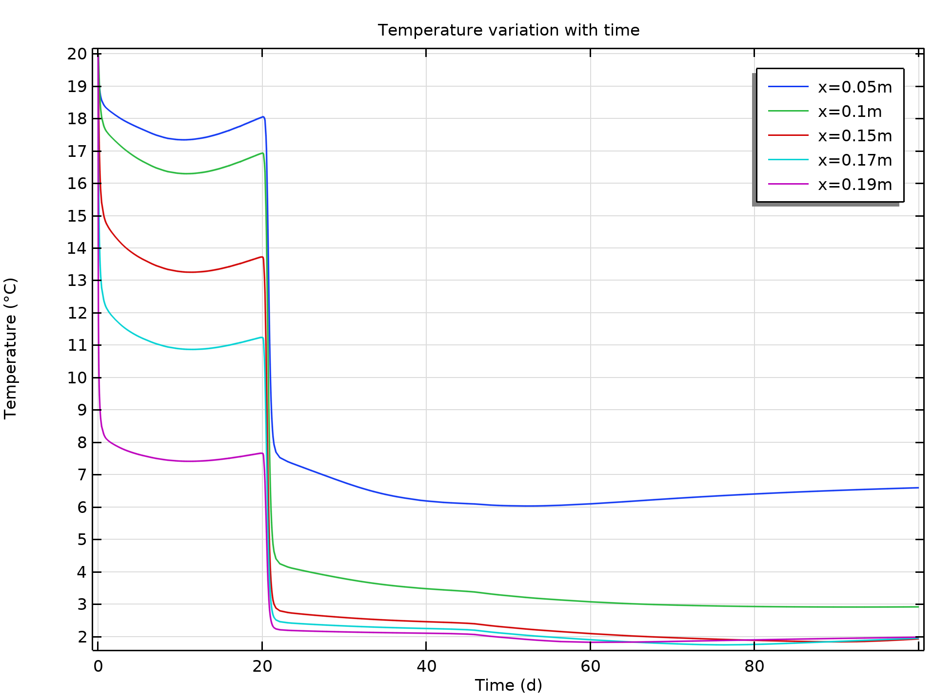
Temperature variation with time
Change in airflow direction
These results fit very well the other numerical results given with the benchmark description, in terms of amplitude and variation.
Variation of temperature in time at different sections of the wall

Slide 7
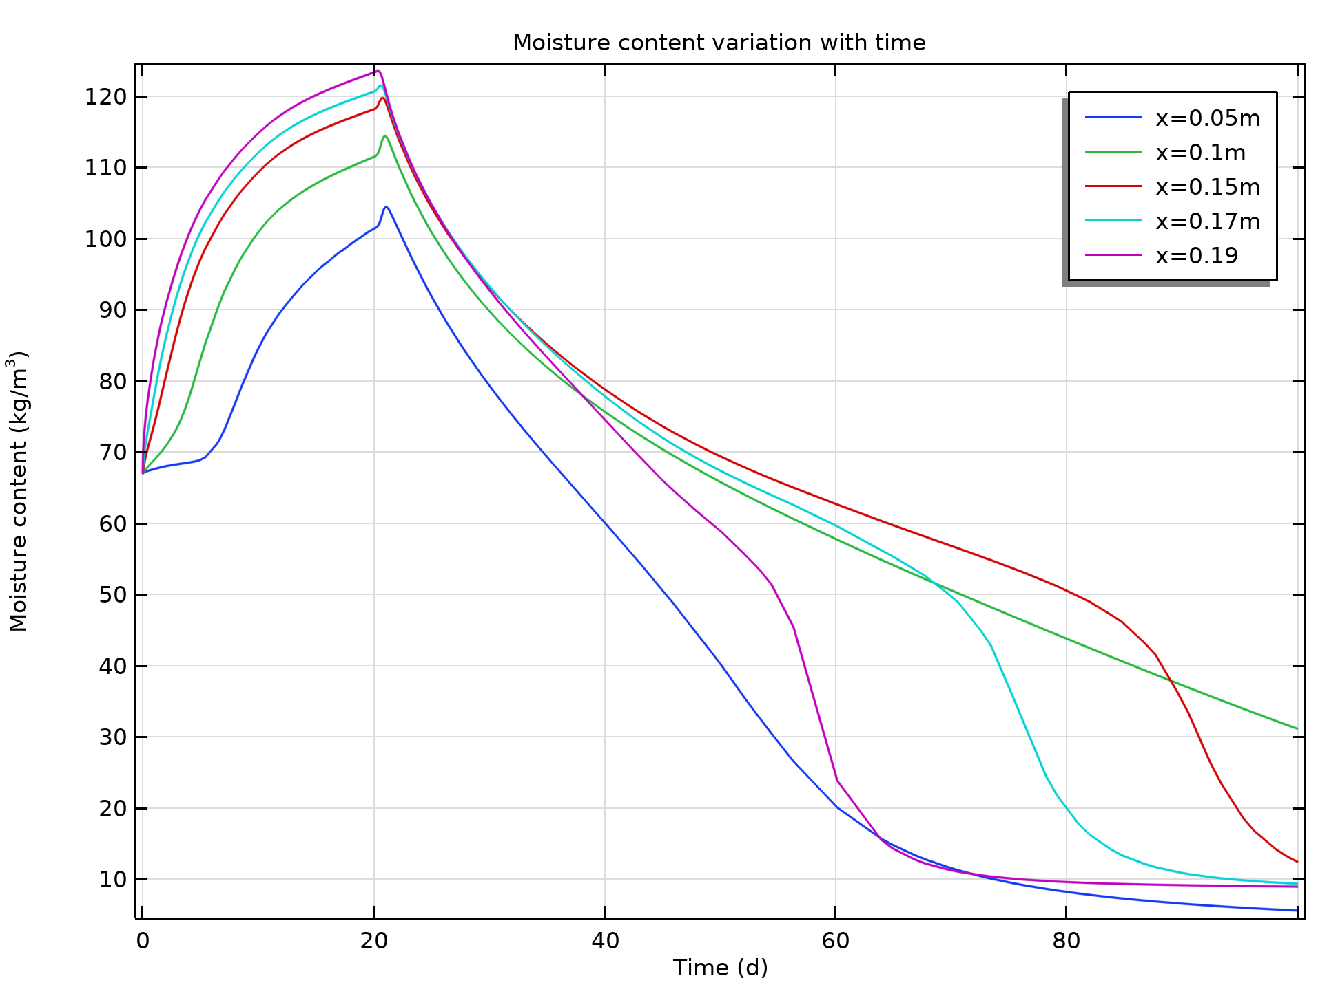
Moisture content distribution in time
During the first 20 days, when airflow goes from the interior to the exterior, the moisture content in the wall is increasing.
When the airflow is reversed, the moisture content decreases. The points that are close to the exterior switch to the sharp decreasing at the end.
The results show good agreement with the benchmark data.
Change in airflow direction
Variation of moisture content in time at various sections of the wall

