Slide 1
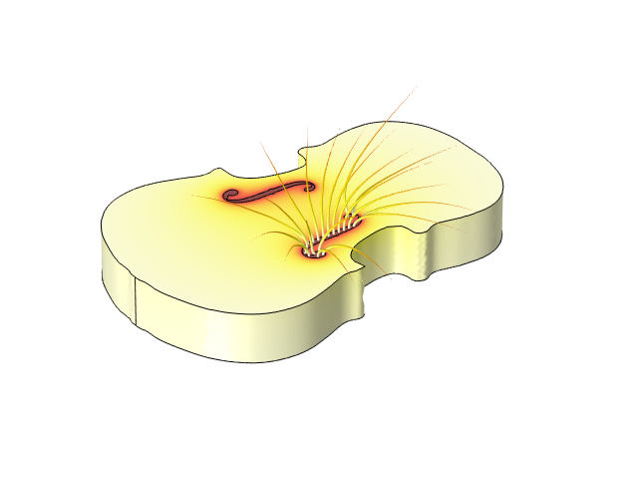
Air Flow through
Violin Sound Holes

Slide 2
Summary
The air flow at air mode resonance through two different types of sound holes is investigated
The model uses the Compressible Potential Flow interface
The air flow through f-shaped holes is revealed to be significantly greater than through round holes with the same area

Slide 3
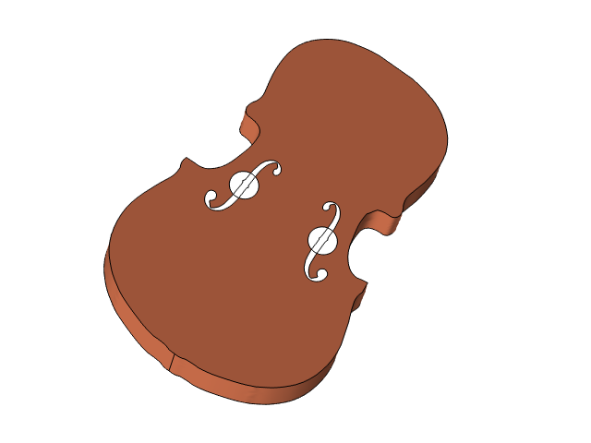
Geometry
The two different kinds of air holes are superimposed
The simulation is performed in the air outside of the violin
The air volume is a large sphere

Slide 4
Model Setup
The Compressible Potential Flow equation is solved for the velocity potential and density in the space outside the violin
The potential is set to 1 on the surface of the holes and 0 on the surface of the air sphere
A no flow (insulation) condition is used on the surface of the violin

Slide 5
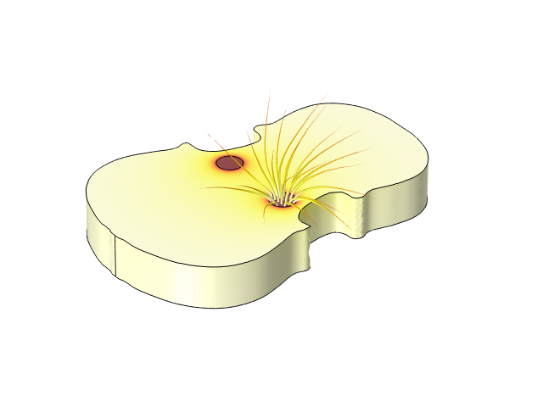
Results
The plots show the velocity potential distribution on the surface of the violin, and the flow out of one of the holes
The flow through the f-holes is 1.51 times greater. This is evident from the air flow computed in the last evaluation group.

