Slide 1
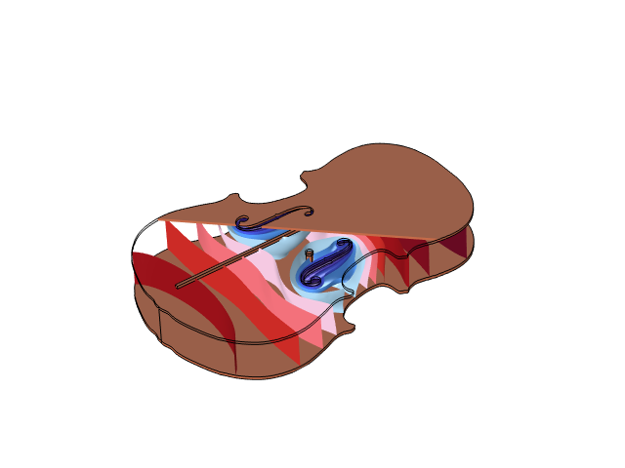
Air Mode
Resonance in a Violin

Slide 2
Summary
The ~300 Hz air mode resonance in a violin is studied
First, a pressure acoustics model with the violin body treated as rigid gives an
approximate result
Secondly, an acoustic-structure interaction model reveals that the pressure acoustics solution is approximately 6% too high

Slide 3
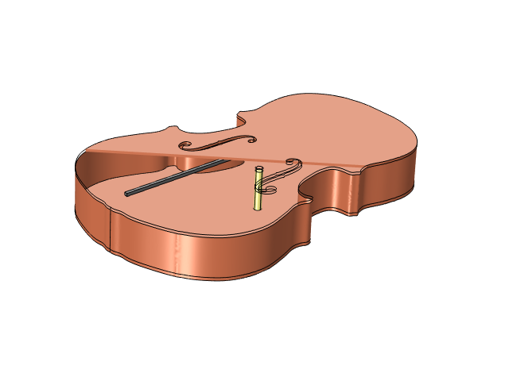
Geometry
The geometry is made to be relatively simple while still including
relevant parts:
  Flat top and bottom plates
  Rigid side walls
  f-shaped sound holes
  A bass bar (in gray) fixed underneath the top plate
  A sound post (in yellow) connecting
  the plates

Slide 4
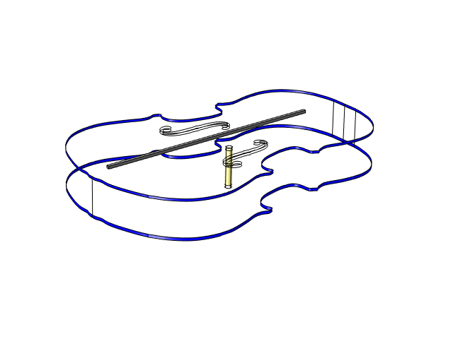
Model Setup, Acoustic-Structure Interaction (ASI)
In the Solid Mechanics interface, the top and bottom plates are fixed at the sides
The automatically applied acoustic-structure boundary multiphysics condition couples the pressure force to the solid and the vibrations back to the pressure
The violin is taken to be made of spruce, with a Young’s Modulus of 10 Gpa
This model is solved in Study 1

Slide 5

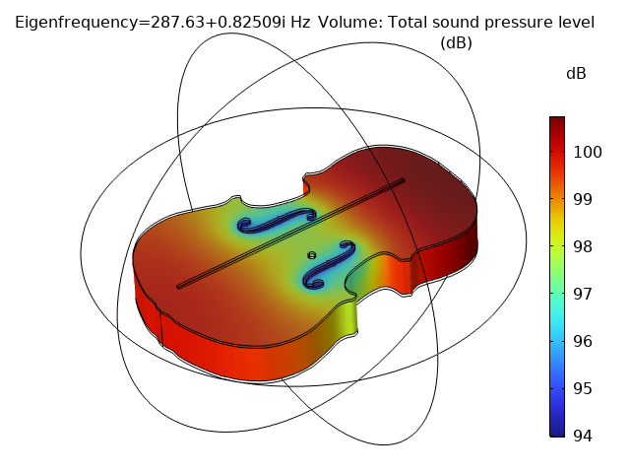
Results, Acoustic-Structure Interaction (ASI)
The resonance is at 287 Hz

Slide 6
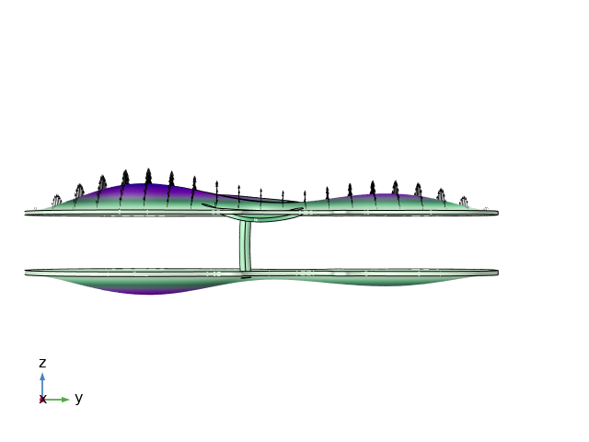
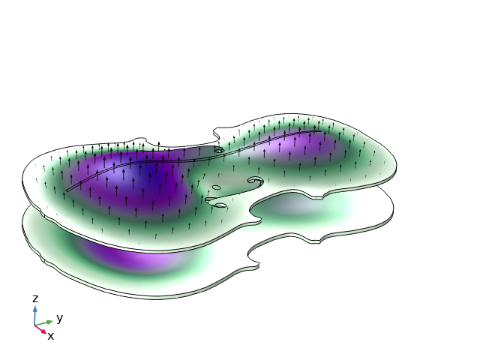
Results, Acoustic-Structure Interaction (ASI)
At the phase of maximum pressure inside the violin, the plates are pushed outwards

Slide 7
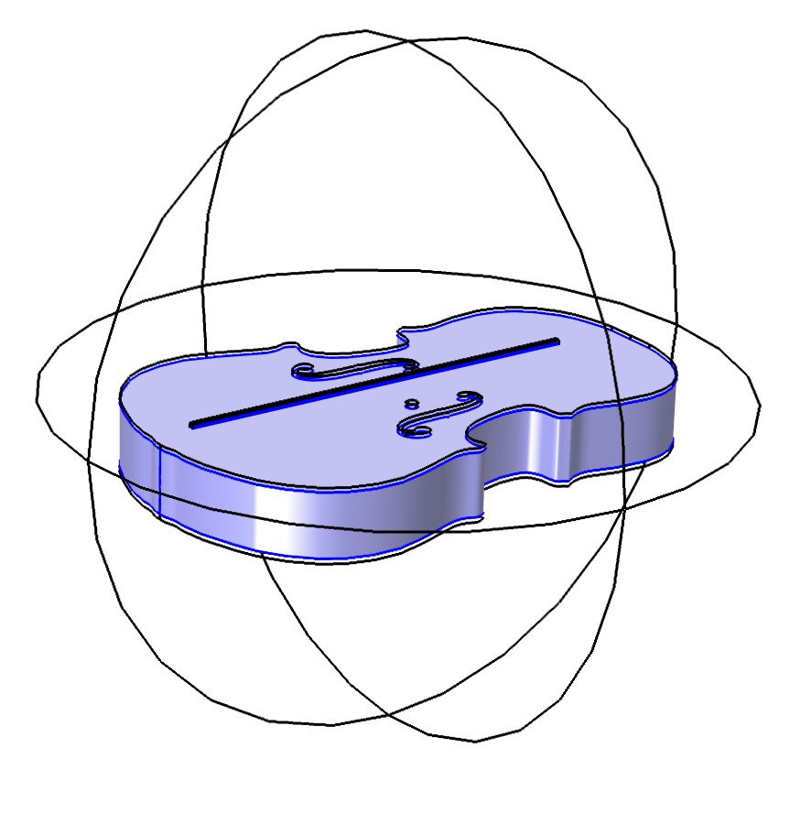
Model Setup, Pressure Acoustics (rigid violin)
An air sphere outside the body lets the mode decay some distance out of the
f-holes
A perfectly matched boundary is used on the surface of the sphere
The violin surface is considered
sound hard, that is, the violin is rigid
An eigenfrequency analysis gives the eigenfrequency and mode shape
This model is solved in Study 2

Slide 8
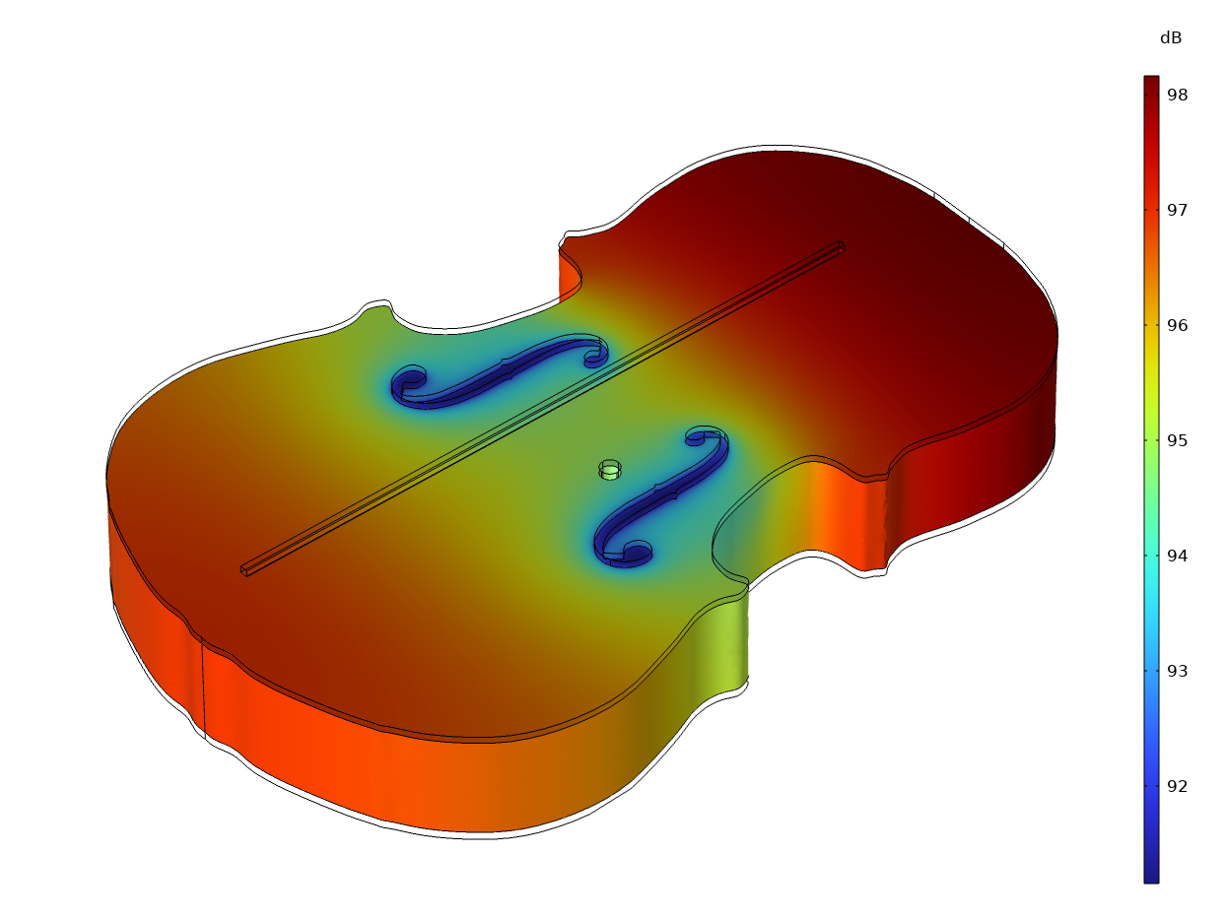
Results, Pressure Acoustics (rigid violin)
The lowest air mode resonance is found at 304 Hz

