Slide 1
Energy Conservation with Thermoviscous Acoustics

Slide 2
Background and Motivation
This small tutorial model illustrates energy conservation when using the Thermoviscous Acoustics, Frequency Domain physics interface. This particular model consists of a small conceptual test setup of a main pipe with a side Helmholtz resonator. Critically, the resonator is connected to the main tube via a very narrow neck.
The acoustics in the narrow neck and the resonator are modeled with Thermoviscous Acoustics for a detailed analysis of the thermal and viscous losses.
In order to study and verify energy conservation, the model compares the total dissipated energy in the acoustic boundary layer to the total input minus output power of the system.
The inlet and out let to the system are modeled using port boundary conditions which simplifies computing the energy balance considerably with the built in postprocessing variables.

Slide 3
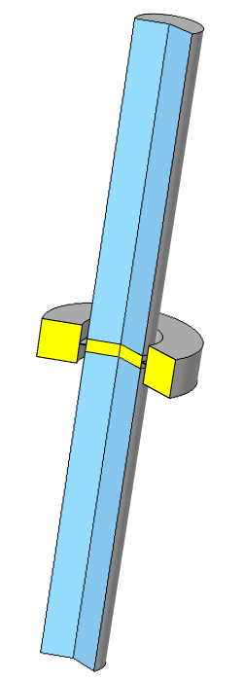
Geometry and Setup
Outlet (port 2)
The acoustics in the system are driven by an external incident plane wave at the inlet port. A port is also added at the outlet.
The axial symmetry of the system is exploited for computational efficiency.
The viscous, thermal, and total dissipated energy density is available as the postprocessing variables:
ta.diss_visc (viscous)
ta.diss_therm (thermal)
ta.diss_tot (total)
The total dissipated power density is given by the volume integral of the above variables using the integration operator intop_dom() defined under Definitions.
Pressure Acoustics
Thermoviscous
Acoustics
Helmholtz resonator
Inlet (port 1)

Slide 4
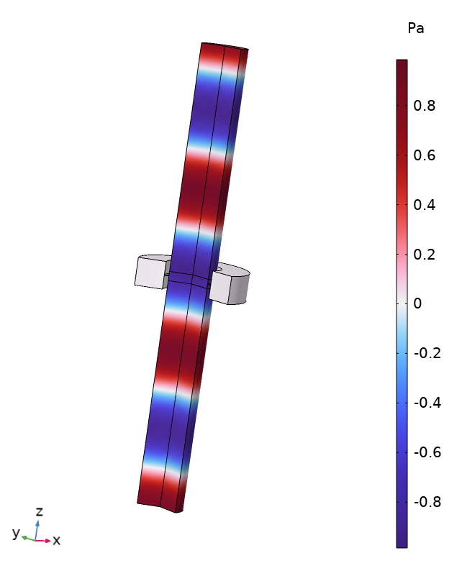
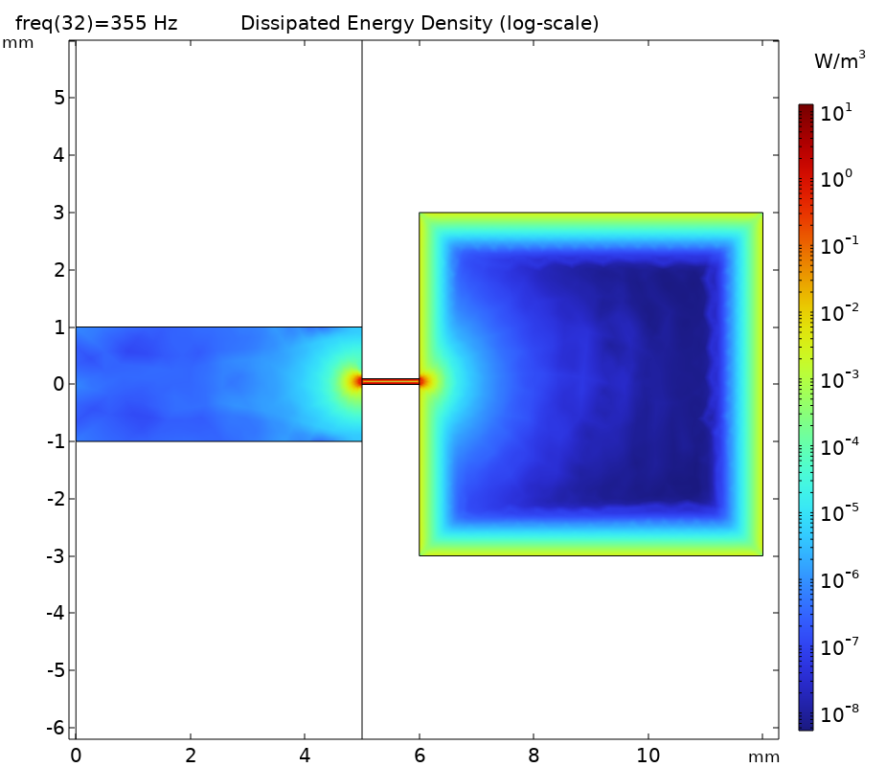
Results

Slide 5
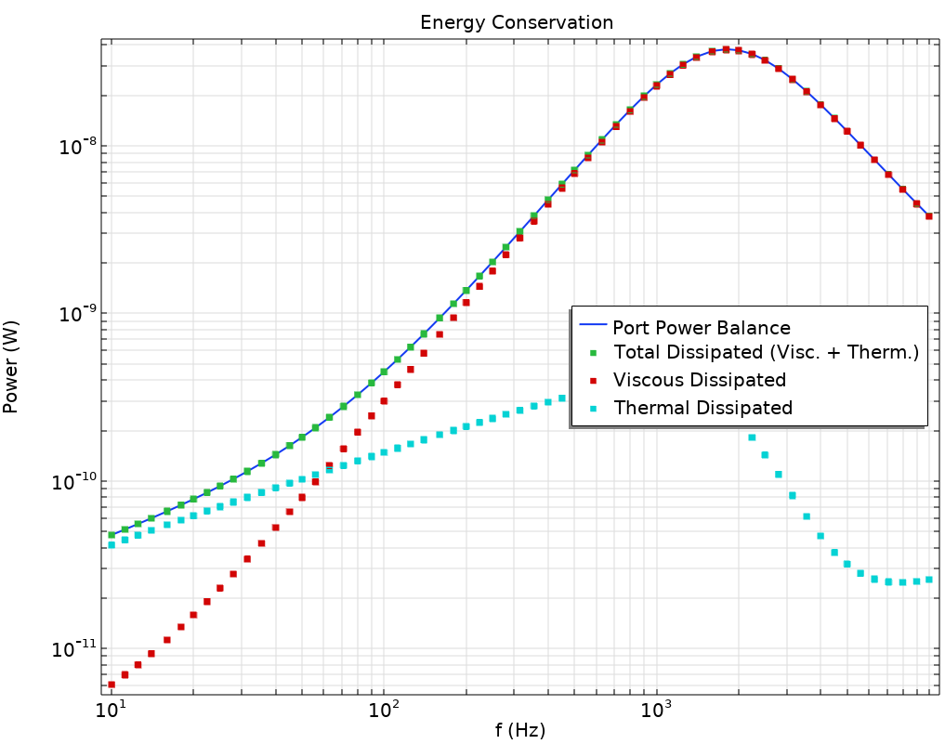
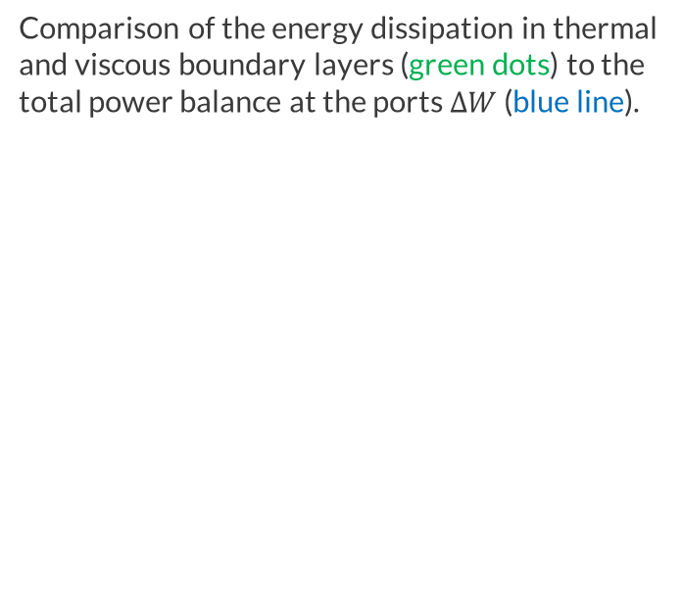
Results
Comparison of the energy dissipation in thermal and viscous boundary layers (green dots) to the total power balance at the ports $ΔW$ (blue line).
$$ΔW=W_{incident}−\left(W_{scattered}+W_{outlet}\right)$$

Slide 6
comsol.com

