Slide 1
Green House Effect

Slide 2
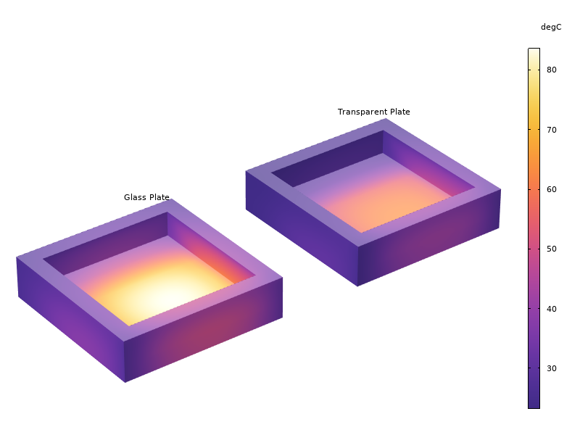
Introduction
Surface-to-surface radiation with solar and ambient spectral bands coupled to the heat transfer physics interface
Implements a simple example of green house effect by trapping thermal radiation in a black cavity
Temperature (°C) distribution in the cavity at 4 pm.

Slide 3
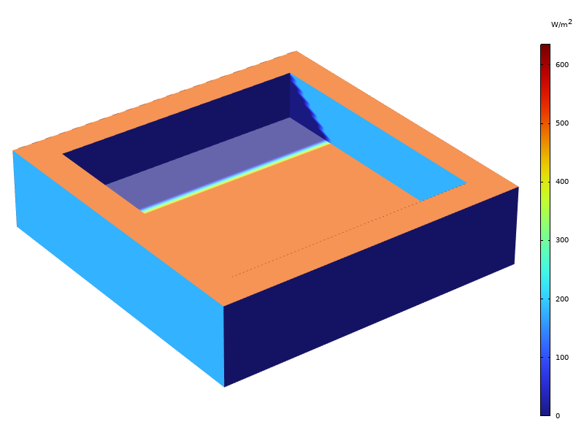
Model Definition
Acrylic plastic box containing air and covered by a thin plate
We consider two setups:
  Fully transparent plate
  Transparent plate only for solar radiation
External irradiation (W/m^2) for the solar spectral band with the transparent plate setup at 4 pm.

Slide 4
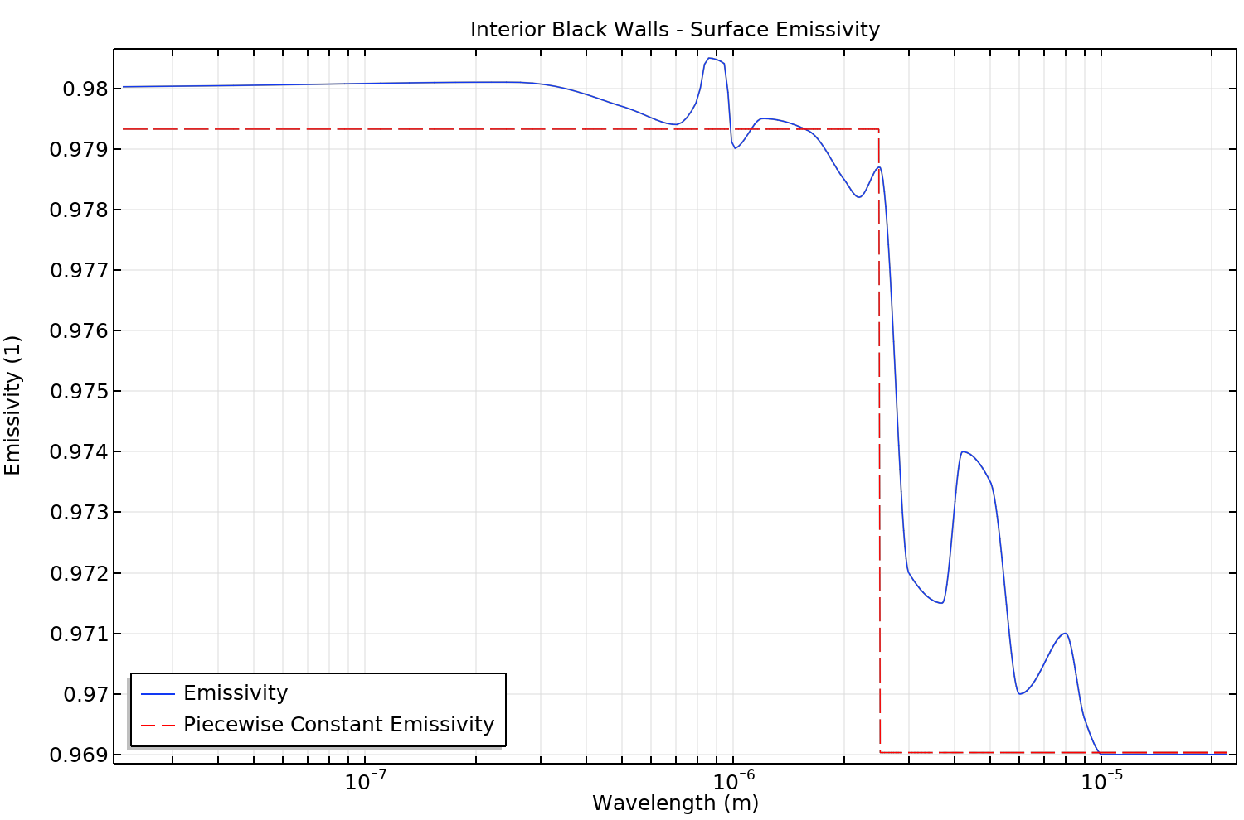
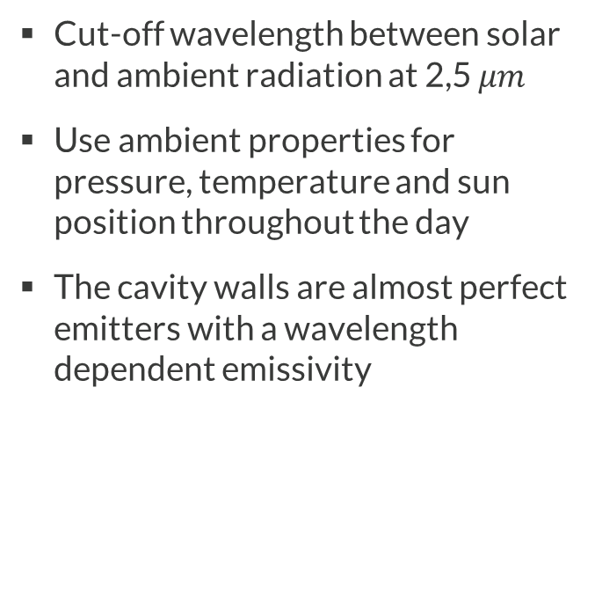
Model Definition
Cut-off wavelength between solar and ambient radiation at 2,5 $μm$
Use ambient properties for pressure, temperature and sun position throughout the day
The cavity walls are almost perfect emitters with a wavelength dependent emissivity
Interior black walls surface averaged emissivity.

Slide 5
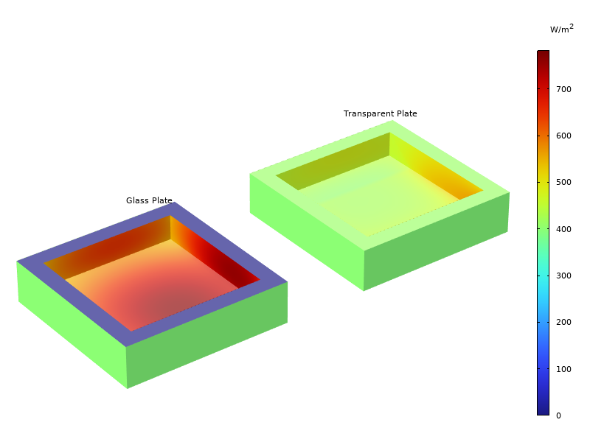
Surface Irradiation
Thermal radiations emitted by the cavity walls are trapped by the opaque glass plate
It leads to a warming of the cavity
Surface irradiation (W/m^2) for the ambient spectral band at 4 pm.

Slide 6
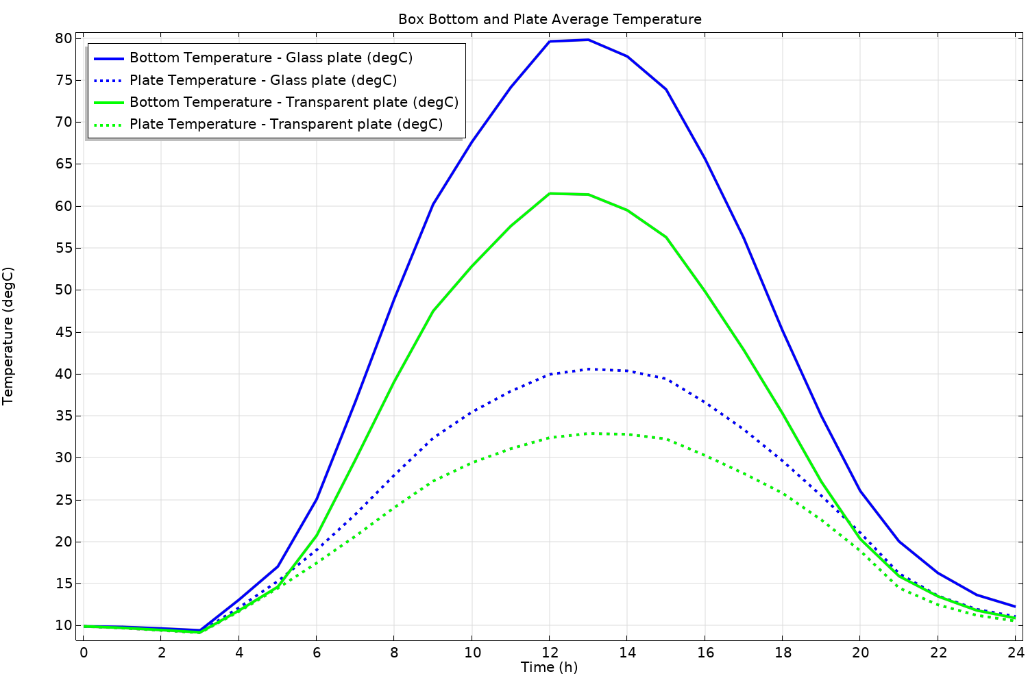
Temperature Dynamics
Temperature averaged within the cover plate or over the cavity’s bottom surface
Higher values for the glass plate setup compared to the transparent plate setup
Space averaged temperatures (°C) during the day.

Slide 7
Conclusion
Simplified model demonstrates the green house effect
Possible improvements with multiple spectral bands
For real-life green house effect, the high emissivity surface is replaced by the earth surface. Earth atmosphere with green house gases act as the semi-transparent glass plate

